Slide 1

MA1506 Mathematics II
Chapter 2
More Applications of ODEs

Slide 2
In Chapter two,
we are interested in properties of solutions
We have learnt how to solve those ODEs
in Chapter one, so we are not interested in
how to solve those ODE here
You don’t have to memorize
those complicated solutions
But you need to know how to
derive the properties from the solutions
My presentation is different from the L. N.. However
the content remains unchanged.

Slide 3
Introduction
In this chapter , first we study an
importance system called Harmonic
Oscillator which is an application of 2nd
order linear ODE
The ODE for harmonic oscillator is given
by

Slide 4
Notation
Introduction
In this chapter
may be denoted by or
may be denoted by or

Slide 5
Introduction
We shall consider four types of HO
(1)Simple harmonic oscillator (pp 1-11)
where m (mass) and k (spring constant)
are positive numbers
Its motion is periodic, called simple
harmonic motion (SHM)

Slide 6
Introduction
(2)Damped harmonic oscillator (pp 11-16)
In real oscillator, friction (damping) slows
down the motion of the system. The
frictional force is given by
m >0 b >0 k > 0
Damping constant
spring constant

Slide 7
Introduction
(3) Forced harmonic oscillator without
damping (pp17-23)
The system is a simple harmonic oscillator
driven by EXTERNALLY applied force F(t)

Slide 8
Introduction
(4) Forced harmonic oscillator with
damping (pp 24-27)
The system is a damped harmonic
oscillator driven by an EXTERNALLY
applied force F(t)

Slide 9
2.1 The simple harmonic oscillator (motion)
I have changed the subtitle “The harmonic oscillator”
to “ The simple harmonic oscillator (motion)”,
since it is more precise.
I shall introduce the general theory before talking about
Pendulum.
The equation of simple harmonic motion is
m, k >0, k called spring constant

Slide 10
(cont)
2.1 Simple harmonic oscillator
Simple harmonic motion SHM can serve
as a mathematical model of a variety of
motions, such as a pendulum with small
amplitudes and a mass on a spring
See
http://en.wikipedia.org/wiki/Simple_harmonic_motion

Slide 11
(cont)
2.1 Simple harmonic oscillator
For SHM equation
It is typical to define the quantity
and write this equation
as

Slide 12
(cont)
2.1 Simple harmonic oscillator
The general soln of the equation is
which can be written as
the phase-amplitude form
(see Appendix 1)
See Chapter 1
amplitude
phase or phase angle

Slide 13
(cont)
2.1 Simple harmonic oscillator
Note that
Hence SHM is periodic with period
and amplitude A

Slide 14
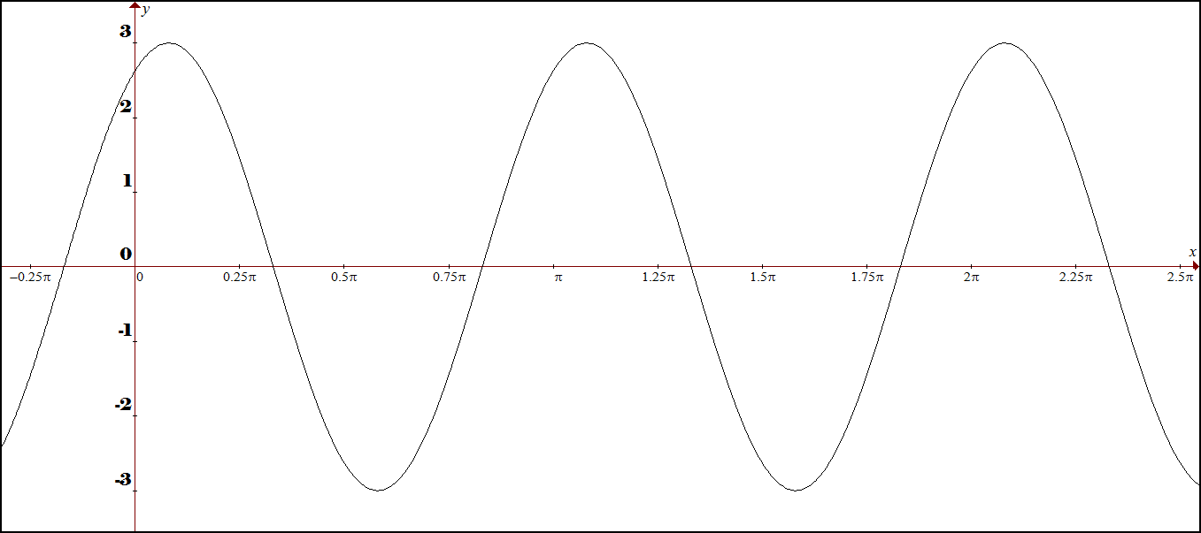
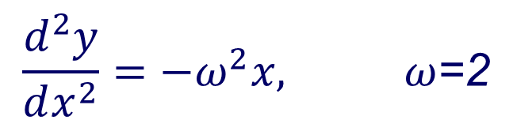

$$\frac{d^{2}y}{dx^{2}}={−ω}^{2}x, ω\text{=2}$$
$$\left.y=3cos(2x−0.5\right)$$
with initial condition given

Slide 15
Some Technical Terms
2.1 Simple harmonic oscillator
Period T=
The time for a single oscillation (cycle)
Frequency f = the reciprocal of the
period T =
The number of cycles per unit time

Slide 16
(cont) Some technical terms
2.1 Simple harmonic oscillator
Angular frequency=
The number of cycles per unit time
Amplitude is the maximal displacement from the equilibrium position

Slide 17
Why ?
2.1 Simple harmonic oscillator
In fact it can also be written as one of the following forms

Slide 18
(cont)
2.1 Simple harmonic oscillator
Two constants A and
are determined by initial conditions
Suppose
Then
and
So we can find A and , for example,

Slide 19
2.1 .1 Stability of SHM
For SHM, amplitude
Hence when , are close to 0,
amplitude is close to zero
Consequently its solution is also close to
Zero solution
Now we shall talk about this zero solution

Slide 20
(cont)
2.1 Simple harmonic oscillator
A solution x(t) of ODE is said to be an
equilibrium solution (equilibrium point)
if x(t) is a constant function (never move)
An equilibrium soln (point) is said to be
stable if any soln with an initial point close
to the equilibrium soln stays close to the
equilibrium soln (point)

Slide 21
(cont)
2.1 Simple harmonic oscillator
Hence zero solution of SMH
is an equilibrium solution (equilibrium point)
This zero solution is stable

Slide 22
(cont)
2.1 Simple harmonic oscillator
We remark that in the above discussion of SHM
Minus is crucial
What happens if
(NOT SHM)
Zero function is a solution, but it is NOT stable
Why

Slide 23
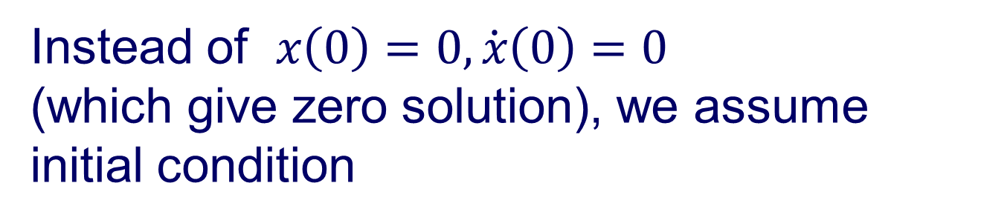
(cont)
2.1 Simple harmonic oscillator
The general soln of
is
Instead of $x\left(0\right)=0,\dot{x}\left(0\right)=0$
(which give zero solution), we assume initial condition
where α is small. Hence this new initial
condition is close to zero solution

Slide 24
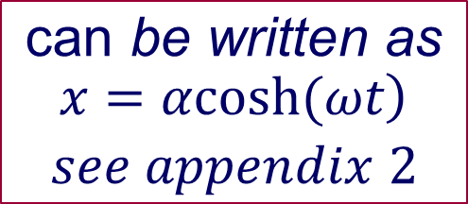
(cont)
2.1 Simple harmonic oscillator
The solution of
is
$$\begin{matrix}\text{can} \text{be} \text{written} \text{as} \\ \begin{aligned}\left.x=αcosh(ωt\right) \\ see appendix 2\end{aligned}\end{matrix}$$
Exponential function grows very quickly,
so this solution does not stay close to zero soln
Hence zero solution is NOT stable

Slide 25
2.1.2 Pendulum with small amplitude (small angle) (pp1-11)
SHM example
rigid
θ=0

Slide 26
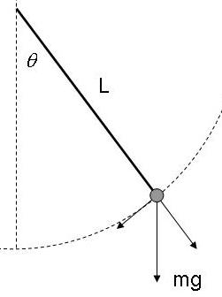
2.1.2 Pendulum with small amplitude
Equation of motion of pendulum is
Hence
Non linear 2nd Order ODE.
arc length
where

Slide 27
2.1.2 (cont)
We shall approximate the above nonlinear ODE by linear ODE
By Maclaurin series(Taylor series at 0) of
When is small , we have

Slide 28
2.1.2 (cont)
where
minus is crucial

Slide 29
(cont)
2.1 Simple harmonic oscillator
So the given nonlinear ODE
can be approximated by
General solution is

Slide 30
2.1 Simple harmonic oscillator
Equilibrium solution of
is
Recall: equilibrium soln
means constant soln
Stable
by section 2.1.1

Slide 31
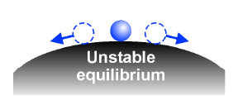
2.1.3 Unstable case (not SHM)
Intuitively, unstable, similar to
When
We also can see it from solution soon

Slide 32
(cont)
2.1.3 Unstable case (not SHM)
θ
mg
θ=0
nonlinear
We measure the angle θ
clockwise

Slide 33
(cont) Unstable Case
2.1.3 Unstable case
The above nonlinear ODE can be approximated by
From last part of section 2.1.1,
we know that the equilibrium soln (pt) θ=0 is not stable and
the general soln is

Slide 34
(cont)
2.1.3 Unstable case
Next, we shall show , by looking at the solution of an example (pp 5-7) , that
this equilibrium soln (pt) θ=0
is not stable
θ=0

Slide 35
(cont)
2.1.3 Unstable case
Suppose initial cond. are given by
Hence
Thus
Hence equilibrium soln 0 is not stable

Slide 36
(cont)
2.1.3 Unstable case
Now we shall show that the pendulum runs away very fast
First
can be written as
(see Appendix 2, why use cosh)

Slide 37
(cont)
2.1.3 Unstable case
Suppose now
centimeters
Hence
Find time t such that
Hence

Slide 38
Remark:
2.1 Simple harmonic oscillator
In approximation, we keep using Taylor series,
and only take the first two terms. In fact we may
get the approximation by using derivative
(small change)
Hence, near the point 0, the value of f(x)
can be approximated by

Slide 39
(cont)
2.1 Simple harmonic oscillator
So
Now consider an example. Let
We want to get the approximate value of
near the point 0

Slide 40
2.2 Damped, Unforced Oscillators pp 11-16
Again I have changed the subtitle, “forced” replaced by “unforced”
m>0, k > 0 , b > 0
Damping constant
spring constant
restoring force
damping force , e.g., friction,
air resistance

Slide 41
2.2 Damped, Unforced Oscillators
m>0, k > 0 , b > 0
Auxiliary equation
Case 1: two real roots
Over damping
Case 2: one root
Critical damping
Case 3: complex roots
Under damping
http://www.aw-bc.com/ide/idefiles/media/JavaTools/vibedamp.html

Slide 42
2.2.1 Damped, Unforced Oscillators (2 real roots)always negative real roots Overdamping
General soln
Overdamping
Goes to zero rapidly
No oscillation

Slide 43
2.2.2 Damped, Unforced Oscillators (one root) Critical damping
General soln
Also goes to zero rapidly
Critical damping
No oscillation
http://www.aw-bc.com/ide/idefiles/media/JavaTools/vibedamp.html

Slide 44
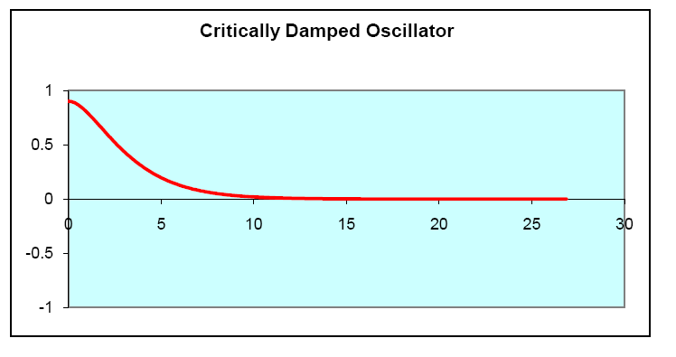
(cont)
Critical damping

Slide 45
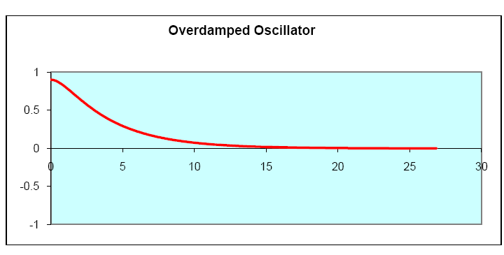
(cont)
Overdamping

Slide 46

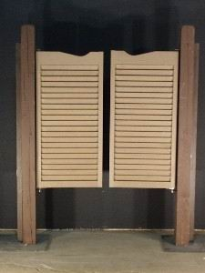
Damping is useful
"Don't let the door hit you on the way out."
A door-closer has two main parts: a spring to close the door, and a damper to prevent the door from slamming shut
Old western swing doors

Slide 47
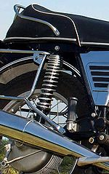
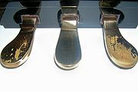
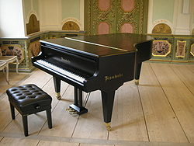
Damping is useful
Damper pedal
Suspension

Slide 48
2.2.3 Damped, Unforced Oscillators (complex roots) Underdamped
General soln
can be written as
underdamped

Slide 49
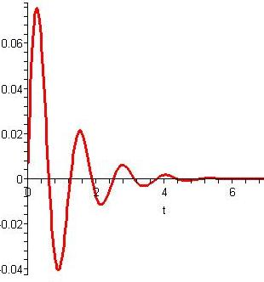
(cont)
underdamped

Slide 50
Damped, Unforced Oscillators (complex roots) underdamped General case
Auxiliary equation

Slide 51
Damped, Unforced Oscillators (complex roots) underdamped General case
General soln
where
(See Chapter1)
can be written as

Slide 52
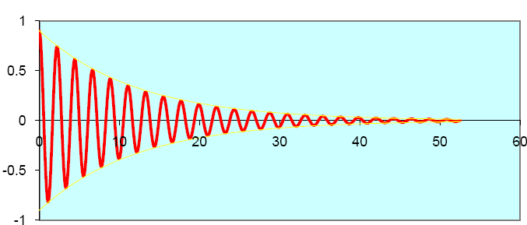
http://www.aw-bc.com/ide/idefiles/media/JavaTools/vibedamp.html
(cont)
2.3 Damped, Unforced Oscillators
Underdamped Oscillator

Slide 53
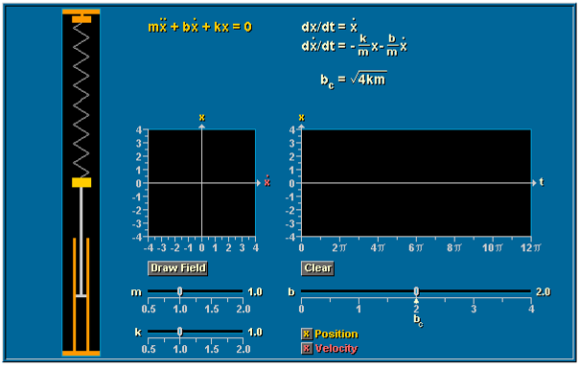
2.2.4 Damped, Unforced Oscillators Example 1
M>0, k > 0 , b > 0
Damped Mass Spring Oscillator
Textbook p196
http://www.aw-bc.com/ide/idefiles/media/JavaTools/massprng.html

Slide 54
2.2.4 Damped pendulum Example 2
with air resistance

Slide 55
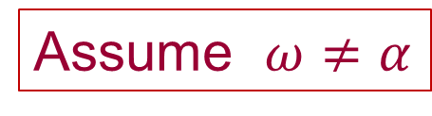
2.3 Forced Oscillators ( pp17-27)
Forced without damping Oscillators ( pp17-23)
General solution of
is (See appendix 3)
Assume $ω≠α$
where
external motor
spring
m

Slide 56
2.3 Forced Oscillators
Forced without damping Oscillators ( pp17-23)
Assume initial condition
get
(See appendix 4)

Slide 57
2.3 Forced Oscillators
Forced without damping Oscillators ( pp17-23)
Small angular frequency when close to
We shall use the above form to discuss
properties of forced oscillator

Slide 58
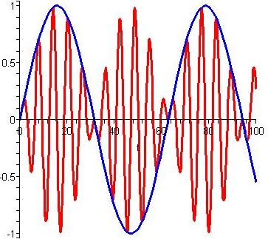
2.3 Forced Oscillators
Forced without damping Oscillators ( pp17-23)
Red curve
where
Blue curve
Red curve

Slide 59
Beating
2.3 Forced Oscillators
if our ear is exposed to two sounds
1st sound
2nd sound
where
we only hear the above term A(t)

Slide 60
(cont) Beating
2.3 Forced Oscillators
A fast signal
is modulated by a slower one
This behavior is called beating in physics
http://www.school-for-champions.com/science/sound_beat.htm

Slide 61
2.3 Forced Oscillators
Forced without damping Oscillators ( pp17-23)
L’ Hospital Rule
or

Slide 62
2.3 Forced Oscillators
Forced without damping Oscillators ( pp17-23)
When external frequency is close to natural frequency , A(t) tends to a st. line

Slide 63
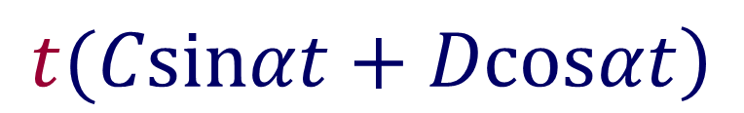

2.3 Forced Oscillators
Forced without damping Oscillators ( pp17-23)
We can understand the above result more
by looking at the following case: when
$$α=ω$$
The particular solution of
is of the from
$$\left.t(Csinαt+Dcosαt\right)$$
The solution of
with
is

Slide 64
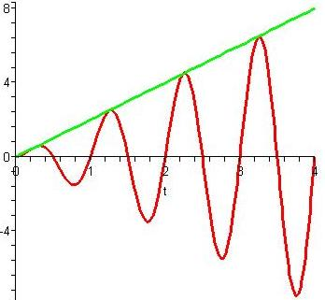

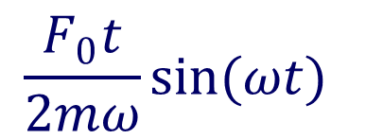
2.3 Forced Oscillators
Forced without damping Oscillators ( pp17-23)
$$\frac{F_{0}t}{2mω}$$
Green curve
$$\frac{F_{0}t}{2mω}sin(ωt)$$
Red curve
blue curve in slide 57 tends to green st. line when tends to
Oscillations go out of control when close to . It is called resonance

Slide 65
Resonance
2.3 Forced Oscillators
If the external force has a frequency
close to the natural frequency of the system,
the resulting amplitudes can be very large even
for small external amplitudes.
It may cause violent motions and even disasters
in bridges and buildings

Slide 66

Collapse of the Tacoma Narrow Bridge. http://www.youtube.com/watch?v=3mclp9QmCGs

Slide 67
Resonance
2.3 Forced Oscillators
(cont)
Avoiding resonance disasters is a major concern
in every building and bridge construction project.
As a countermeasure, a tuned mass damper can
be installed to avoid disaster.
The Taipei 101 building relies
on a 730-ton pendulum
— a tuned mass damper — to avoid resonance.

Slide 68
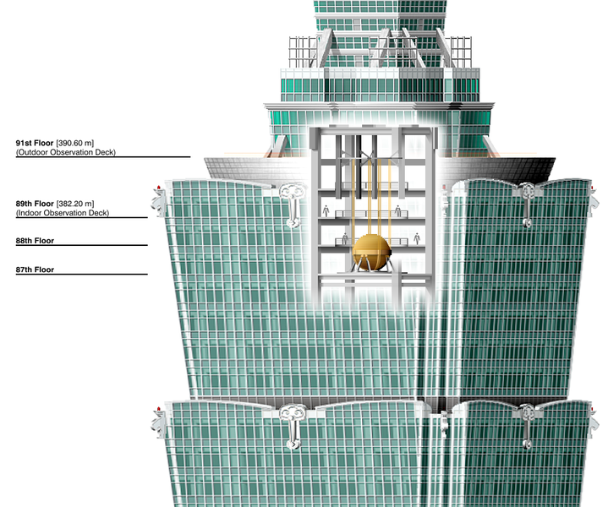
Taipei 101 Tuned Mass Damper

Slide 69
A tuned mass damper is a device mounted in structures to prevent damage caused by vibration
http://en.wikipedia.org/wiki/File:Tuned_mass_damper.gif

Slide 70
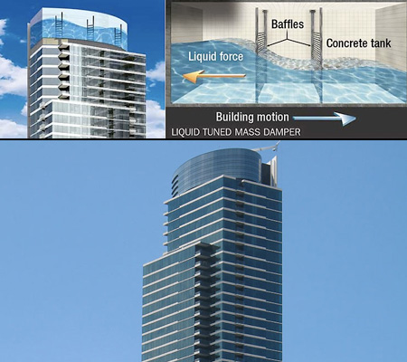
Liquid tuned mass damper

Slide 71
has two important phenomena beating , resonance
Forced without damping Oscillators ( pp17-23)
2.3 Forced Oscillators
We have learnt
Forced , NO damped, Oscillator

Slide 72
Forced Damped Oscillators (pp 24-27)
2.3 Forced Oscillators
sinαt or cosαt never appear in $x_{h}$ see Section 2.2
Hence a particular solution is of the form
We can find A and B, so
(see Appendix 5)

Slide 73
Forced Damped Oscillators (pp 24-27)
2.3 Forced Oscillators
General soln is
+ Gen Sol of
The 2nd part (damped oscillation) tends to zero rapidly, see Section 2.2
Hence 2nd part called transient soln

Slide 74
Forced Damped Oscillators (pp 24-27)
2.3 Forced Oscillators
So when t big enough, the general soln becomes
called steady-state soln (response)
http://www.aw-bc.com/ide/idefiles/media/JavaTools/vibefdmp.html

Slide 75
Forced Damped Oscillators (pp 24-27)
2.3 Forced Oscillators
Oscillation at angular frequency α
when t big enough
X(t) can be written as
where
http://www.aw-bc.com/ide/idefiles/media/JavaTools/vibefdmp.html

Slide 76
Forced Damped Oscillators (pp 24-27)
2.3 Forced Oscillators
Although the steady-state oscillation has
the same frequency as the external force
but it is NOT in phase with the external
Force. (compare with )
The amplitudes of the steady-state
soln and the external force are also
different

Slide 77
Forced Damped Oscillators (pp 24-27)
2.3 Forced Oscillators
where
=amplitude

Slide 78
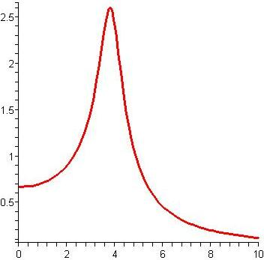
Forced Damped Oscillators (pp 24-27)
2.3 Forced Oscillators
maximum
If
is chosen,
the system will suddenly respond strongly
Amplitude of steady-state response curve

Slide 79
2.4 Conservation pp28-29
We need the following formula in this section
Recall
We shall prove it in next slide

Slide 80
2.4 Conservation
(cont)
Chain rule

Slide 81
2.4 Conservation
In this section, we shall look at
conservative systems
Consider SHM
Let E=
Kinetic energy
+ potential energy
We shall show that E is constant

Slide 82
(cont)
2.4 Conservation
simple harmonic motion
First
from slide 80
Next

Slide 83
2.4 Conservation
(cont)
From
and previous slide
get

Slide 84
(cont)
2.4 Conservation
Hence
where E
is a constant
kinetic energy
potential energy
Hence the kinetic energy + potential energy
of the system remains constant
This system is called conservative system

Slide 85
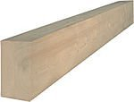
2.5 EULER’s equation (Cantilevered Beams) pp30-37
Beam—long, thin object
Cantilevered Beam (supported at only one end)
y
x
beam must bend

Slide 86
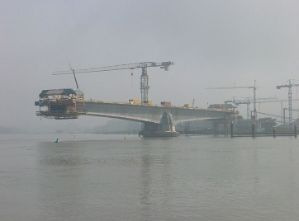
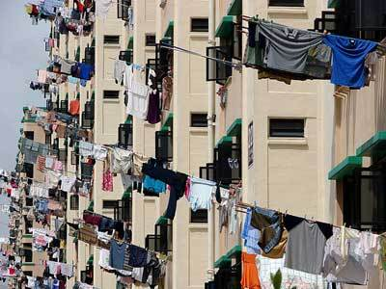
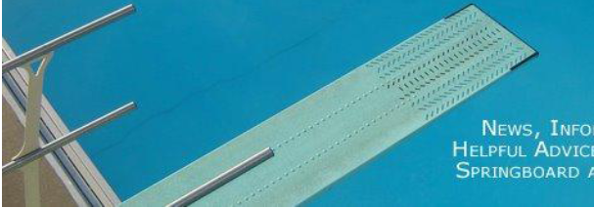
3.7 Cantilevered Beams

Slide 87
3.7 Cantilevered Beams
In this section, we will discuss bending of
a cantilevered beam
Why bending?
It is due to the weight of the beam and
other forces acting on the beam, called
load W(x)=force per unit length at point x
OUR Convention is that W(x) is positive in
UPWARD direction
y
W(x)
x

Slide 88

3.7 Cantilevered Beams
Load=weight of
springboard
Load=weight of bamboo
stick+clothes
Load=weight of springboard + swimmers

Slide 89
3.7 Cantilevered Beams
Bending depends on W(x), stiffness, and
shape of the cross-section.
The stiffness is measured by a constant E
called Young’s modulus.
The cross-section is measured by a
constant called the second moment of
area.

Slide 90
3.7 Cantilevered Beams
The equation of the beam is given by 4th order ODE, Euler’s equation, (proof omitted)
Recall the direction of load W(x)
y
W(x)
x

Slide 91
3.7 Cantilevered Beams
y
x

Slide 92
Find max deflection
3.7 Cantilevered Beams
Δ
Assume: uniform mass
y
for all x
L
x
Δ
Then
α
Recall W(x)=force per unit length at point x

Slide 93
3.7 Cantilevered Beams
To find
Δ
i.e. to find
we need to solve
This is 4th order ODE,
we need FOUR conditions
Here are the conditions

Slide 94
3.7 Cantilevered Beams
y
Proof omitted
No moment at L
x
Proof omitted
L
No shear force at L

Slide 95
3.7 Cantilevered Beams
Now solve this 4th order ODE with four conditions
integrate
both sides get
By
get

Slide 96
3.7 Cantilevered Beams
integrate
both sides get
By
get

Slide 97
3.7 Cantilevered Beams
integrate
both sides get
By
get

Slide 98
3.7 Cantilevered Beams
Integrate both sides get
By
get

Slide 99
3.7 Cantilevered Beams
y
x
Beam equation

Slide 100
Cantilever deflection formula
3.7 Cantilevered Beams

Slide 101
Remark:
In the above example, we assume that
In tutorial and past year exam questions,
we will consider the following cases:

Slide 102
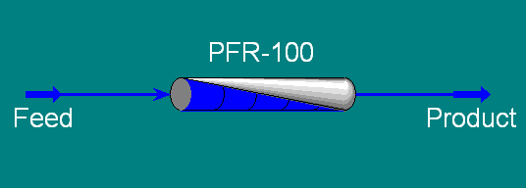
2.6 Plug flow reactor (PFR) model pp38-48
The plug flow reactor (PFR) model is used to
describe chemical reactions in continuous,
flowing systems.
PFR is like a long tube into which you push
some mixture of chemicals which move through
the tube while they react with each other.

Slide 103
3.6 PFR model
Assume
Velocity u of flow is constant
Cross-sectional area A is constant
Temp constant
No mixing upstream or downstream----everything that happens in a small region of the PER is controlled by chemical reactions IN that region
, and by mixture of chemicals following
in and out ( see next two slides)

Slide 104
Now we shall use the following example to illustrate the idea of PFR model
3.6 PFR model
H₂
H₂O
H₂O
H₂O
H₂
H₂
H₂
O₂
O₂
O₂
O₂
x
Assumption: A lot of Oxygen pumped in at velocity u
Hydrogen pumped in at velocity u
Keep pumping

Slide 105
Q: At point x, how many molecules of
3.6 PFR model
are passing by second?
Let C(x) be concentration of at point x.
i.e., C(x)= # of molecules /cubic meter at x
Then in a time
Let
be the number of
that pass by
Since
we have
So

Slide 106
3.6 PFR model
Now consider a small piece of tube, called plug,
Let the length of plug is
flowing in at x,
at a rate
flowing out at x+δx,
at a rate
molecules are being destroyed inside the plug
at a rate

Slide 107
Why
What is r ?
r is rate per volume at which the chemical reaction
2H₂ + O₂ = 2H₂ O
Volume of
plug is
happens in each unit of volume
Hence
is the # of reactions happens
in the plug per second
Why minus 2 ? Because we are losing
and the 2 because each reaction costs 2 molecules
So in each second, the # of
molecules
being destroyed inside the plug is

Slide 108
flowing in
at a rate
flowing out
at a rate
destroyed
at rate
Hence
So
Hence

Slide 109
3.6 PFR model
It is known that the rate of chemical reaction
r depends on concentration C(x) of and
temperature
We assume temperature is constant
Hence r=k C(x) where k is a constant
So

Slide 110
3.6 PFR model
Solve the above ODE, get
How to find B? Let x=0, we get

Slide 111
3.6 PFR model
Therefore
Remark:
In the above, we assume
area A of cross section is constant
and we have
If A is not constant, then we will have
In this case, following the same idea as above, we will have
END

Slide 112
Appendix 1
By the above formula, get
Hence
where

Slide 113
Appendix 2 (Defintions of cosh and sinh)
Formulae

Slide 114
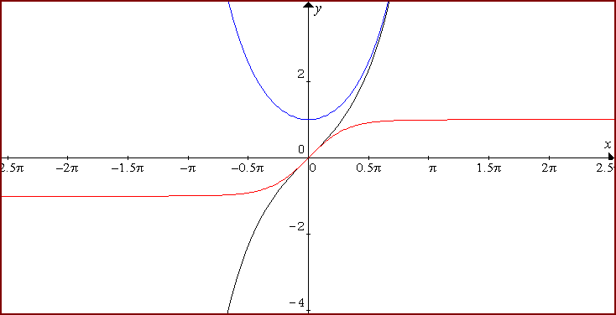
Appendix 2 (cont) Graphs of sinhx, coshx, tanhx
http://www.graphmatica.com
coshx
sinhx
tanhx
tanhx
sinhx

Slide 115
In slide 36, we compute t using cosh function as follows:
Appendix 2 (cont)
Suppose now
centimeters
Hence
Find time t such that
Hence

Slide 116
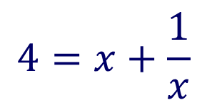
Suppose we use the following exp. function instead of cosh
Appendix 2 (cont)
Then
We get
$$4=x+\frac{1}{x}$$
Let
Solve the above eq , get the value x,
and then get the value t (choose positive t).
Hence using cosh is easier.

Slide 117
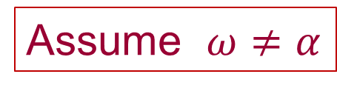
Appendix 3 solve
Gen Solution
We know
Assume $ω≠α$
where
Now we shall find

Slide 118

(cont)
We guess
Assume $ω≠α$
Then subst.
into
get

Slide 119
Appendix 4
Assume initial condition

Slide 120
Appendix 4 (cont)
By the initial conditions in previous slide, get
So

Slide 121
Appendix 5
We shall find a particular soln
We guess
Then subst.
into

Slide 122
Appendix 5 (cont.)
get

Slide 123
Appendix 5 (cont)
so
END Chapter 2

